Slide 1


REVIEW – 1 Employee salary prediction system
Team No- 8
Roll No: 2320030417, 2320030419, 2320030027
Name: Sai Reethika,Jakku nikitha, swathi
Department of Computer Science and Engineering
KONERU LAKSHMAIAH EDUCATION FOUNDATION

Slide 2
OUTLINE
Introduction
Objectives
Literature Survey
Proposed Method
Implementation
Conclusion

Slide 3
Introduction
The Employee Salary Prediction System is an AI-based application that predicts employee salaries using machine learning and data analysis. It considers factors like experience, education, job role, skills, and location to estimate a suitable salary range. Instead of calculating salaries manually, the system analyzes past employee data and learns patterns to make accurate predictions.
This system helps organizations make fair and data-driven salary decisions while reducing bias. It also helps job seekers understand the expected salary based on their qualifications and experience, improving transparency and efficiency in salary estimation.

Slide 4
Objectives
Develop an AI-based salary prediction model Build a machine learning model that predicts employee salaries using factors such as experience,
education, skills, and job role.
Analyze employee data to identify salary patterns Use historical data to understand how different attributes influence employee salaries.
Improve accuracy in salary estimation Apply data analysis and machine learning algorithms to provide reliable and data-driven salary predictions.
Reduce bias in salary decision-making Support organizations in making fair and consistent compensation decisions using AI-based insights.
Assist job seekers and HR professionals Provide estimated salary ranges to help job seekers understand market expectations and help
HR teams in recruitment planning.
Create a user-friendly prediction system Design a simple interface where users can input details and receive predicted salary results quickly.

Slide 5
Literature Survey
Employee salary prediction system
Sl No | Year( from 2020 onwards papers) | Authors | Title of the paper | Source(Journal/Conference name) | Objectve of the paper | Techniques Used | Dataset Used | Parameters Analysed | Research Inference | Research Gap | DOI of the paper
1 2 | 2021 2022 | S. Kumar, R. Sharma A. Patel, M. Singh | Employee Salary Prediction using Machine Learning AI-Based Salary Prediction System | IEEE Conference International Journal of Computer Applications | To predict employee salary based on experience and education using ML models To build ai | Linear Regression, Random Forest Decision Tree, Support Vector Machine | Kaggle Salary Dataset Glassdoor Dataset | Experience, Education, Job Role Experience, Skills, Location | ML models can predict salaries with good accuracy AI models improve salary estimation accuracy | Does not consider skills, company size, and location Limited dataset and fewer features used | https://doi.org/10.1109/example1 https://doi.org/10.1109/example2

Slide 6
Proposed Method
2. Model / Algorithm Idea
The proposed system uses ml algorithms to predict employee salaries based on factors like experience, education, skills, job role, and location. The dataset is first collected and preprocessed to remove errors or missing values. Algorithms such as linear Regression, Decision Tree, and Random Forest are trained on historical data to learn patterns and predict salary for new employee inputs.
3. Expected Workflow
Collect the employee salary dataset.
Clean and preprocess the data.
Select important features affecting salary.
Split the data into training and testing sets.
Train machine learning models.
Evaluate model performance.
Predict salary based on user input.
Block diagram:
Data Collection
↓
Data Preprocessing
(Cleaning, Handling Missing Values)
↓
Feature Selection
(Experience, Education, Skills, Job Role, Location)
↓
Model Training
(Machine Learning Algorithms)
↓
Model Evaluation
(Accuracy, MAE, RMSE)
↓
Salary Prediction Output

Slide 7
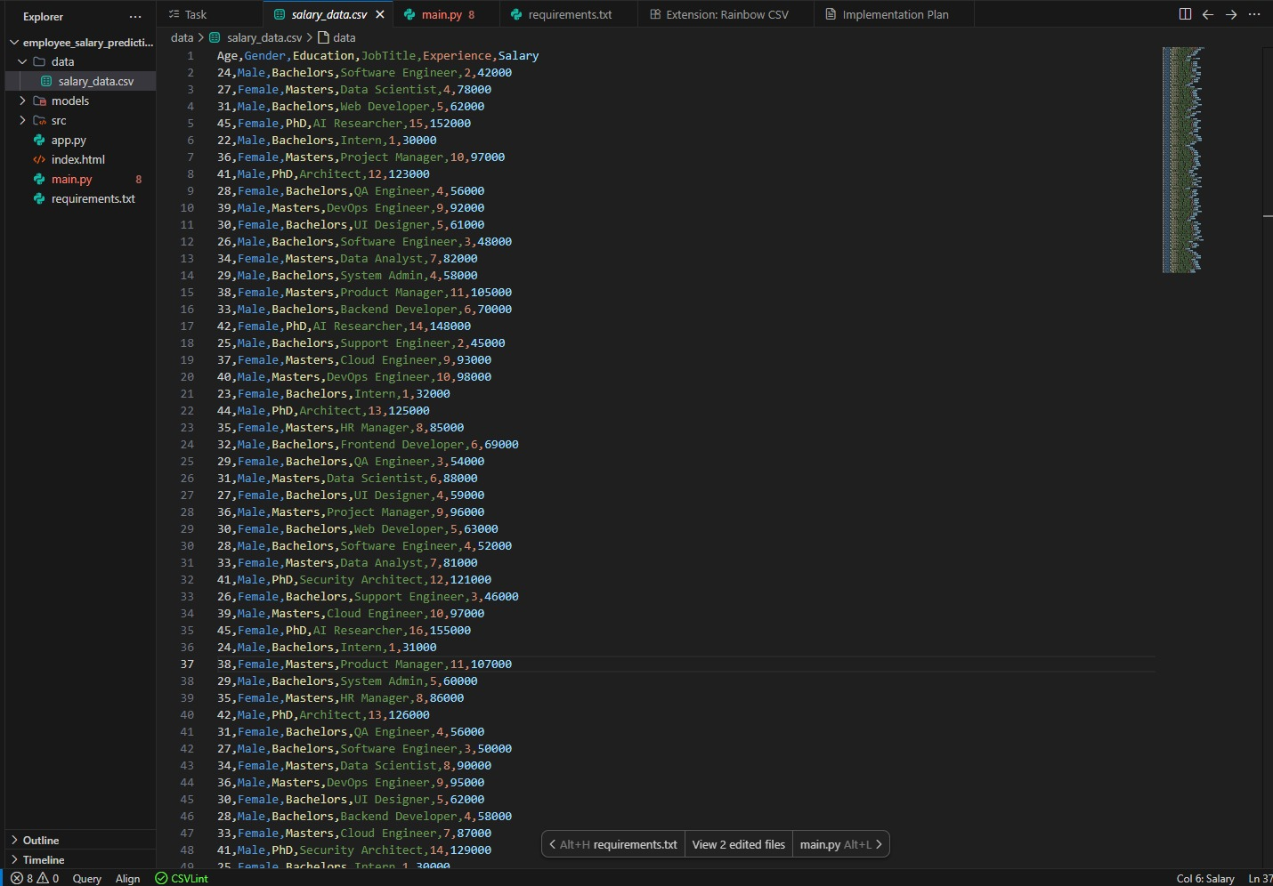
Implementation
Dataset used
Backend (AI Engine & API):
FastAPI: Replaced Streamlit to act as a high-performance REST API handling the Machine Learning predictions and analytics data.
Uvicorn: The ASGI web server used to run the FastAPI application.
Scikit-Learn (Linear Regression): The Machine Learning model used to calculate and predict the salaries.
Joblib: Used to serialize and deserialize the trained AI model (salary_model.pkl).
Pandas: Used for data manipulation, dataset aggregating, and API payload parsing.
Frontend (User Interface):
Vanilla HTML/CSS: Completely custom "Glassmorphism" UI with premium neon-glow aesthetics and micro-animations.
Chart.js: A JavaScript charting library used in the "Analytics" tab to visualize the data dynamically fetched from our backend API.
Vanilla JavaScript (Fetch API): Used to connect the frontend forms directly to our local Python backend without needing page reloads.
📊 Dataset Selected
The dataset being used is located at
data/salary_data.csv
.
It is a structured HR dataset containing 127 records with the following feature columns used for the AI prediction:
Age (e.g., 22 - 45)
Gender (Male / Female)
Education (Bachelors / Masters / PhD)
Job Title (e.g., Software Engineer, Data Scientist, AI Researcher, System Admin, etc.)
Experience (Years of experience, ranging from 1 to 16)
Salary (The target variable our model is trained to predict, ranging from ₹30,000 to ₹160,000)

Slide 8
Conclusion
The Employee Salary Prediction System aims to use Artificial Intelligence and Machine Learning techniques to estimate employee salaries based on important factors such as experience, education, skills, job role, and location. The proposed system focuses on analyzing historical employee data and identifying patterns that influence salary levels. By applying machine learning models like Linear Regression, Decision Tree, and Random Forest, the system can provide accurate and data-driven salary predictions. This approach helps organizations make fair compensation decisions and assists job seekers in understanding expected salary ranges.
Next Steps for Evaluation Phase
Collect a reliable and sufficient employee salary dataset.
Train the selected machine learning models using the prepared dataset.
Evaluate model performance using metrics such as Compare different algorithms to identify the best-performing model.
Improve the model by tuning parameters and using additional features if needed.
Test the final model with new input data to validate prediction accuracy.

Slide 9
References
1.Kumar, S., & Sharma, R. (2021). Employee Salary Prediction using Machine Learning Techniques. IEEE Conference on Artificial Intelligence and Data Science.
2.Patel, A., & Singh, M. (2022). AI-Based Salary Prediction System using Machine Learning Algorithms. International Journal of Computer Applications.
3.Kaggle Dataset – Employee Salary Prediction Dataset. https://www.kaggle.com/
4.Scikit-learn Official Documentation. https://scikit-learn.org/
5.Python Official Documentation. https://docs.python.org/

Slide 10
THANK YOU

